Slide 1
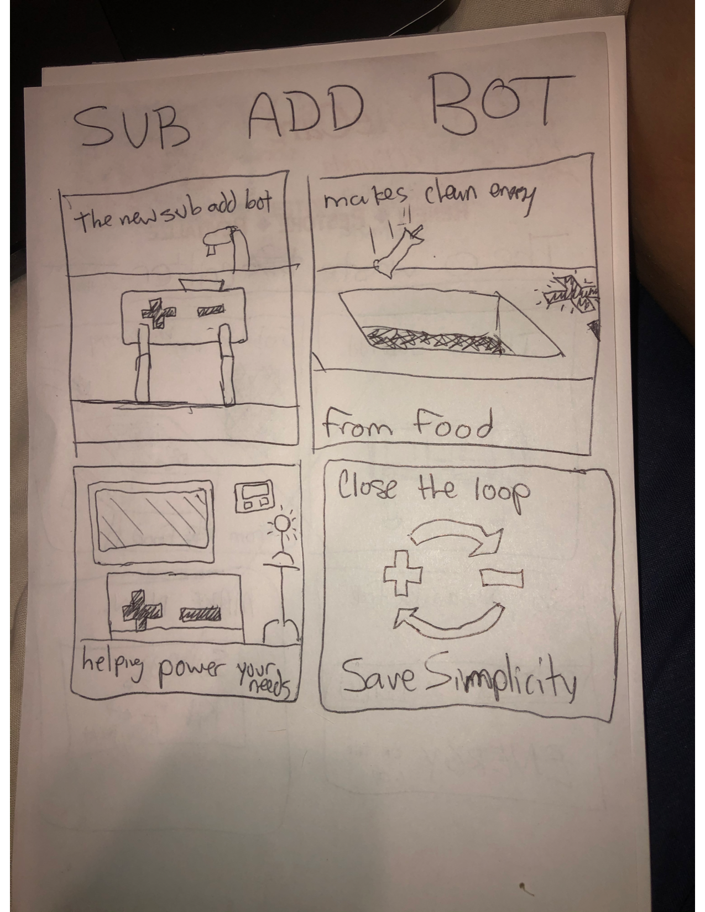
Sub Add bot comic strip
Selling the Sub Add bot! In 4 pictures.

